Slide 1
Machine Learning
AIML CZG565
M5 : Decision Tree Classifier
Course Faculty of M.Tech Cluster
BITS – CSIS - WILP

Slide 2

Machine Learning
Disclaimer and Acknowledgement
These content of modules & context under topics are planned by the course owner Dr. Sugata, with grateful acknowledgement to many others who made their course materials freely available online
We here by acknowledge all the contributors for their material and inputs.
We have provided source information wherever necessary
Students are requested to refer to the textbook w.r.t detailed content of the presentation deck shared over canvas
We have reduced the slides from canvas and modified the content flow to suit the requirements of the course and for ease of class presentation
Slide Source / Preparation / Review:
From BITS Pilani WILP: Prof.Sugata, Prof.Chetana, Prof.Rajavadhana, Prof.Monali, , Prof. Srinath , Prof.Anita, Prof.Sangeetha, Prof.Swarna
External: CS109 and CS229 Stanford lecture notes, Dr.Andrew NG and many others who made their course materials freely available online

Slide 3
Course Plan
M1 | Introduction
M2 | Machine learning Workflow
M3 | Linear Models for Regression
M4 | Linear Models for Classification
M5 | Decision Tree
M6 | Instance Based Learning
M7 | Support Vector Machine
M8 | Bayesian Learning
M9 | Ensemble Learning
M10 | Unsupervised Learning
M11 | Machine Learning Model Evaluation/Comparison

Slide 4
Module 5
Information Theory
Entropy Based Decision Tree Construction
Avoiding Overfitting
Minimum Description Length
  Handling Continuous valued attributes

Slide 5
Decision Tree Classifier

Slide 6
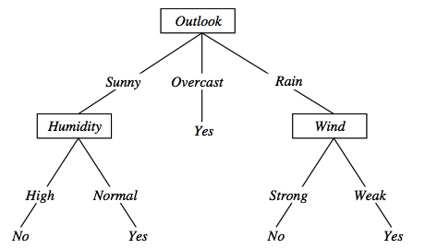
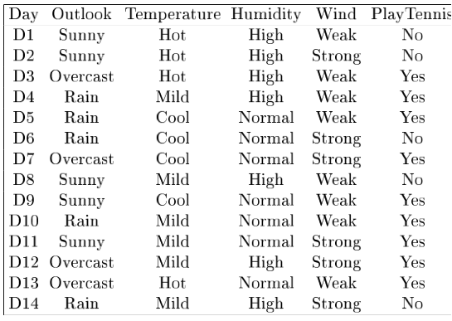
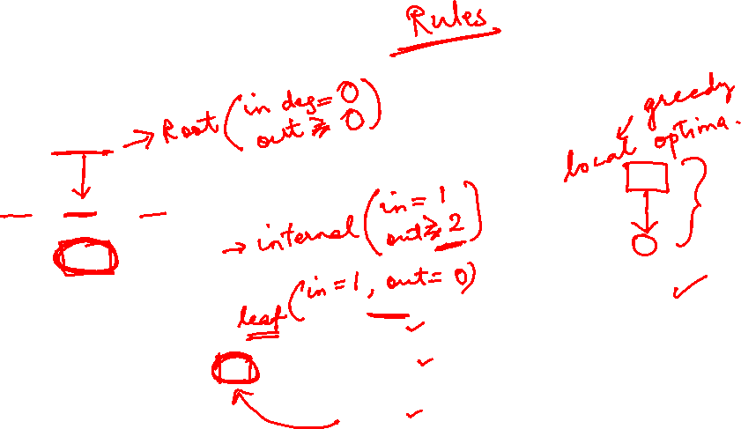
Types of Classification
Decision Theory: Interpretation Model Building
Logistic regression, SVMs , tree based classifiers (e.g. decision tree) Traditional neural networks, Nearest neighbor

Slide 7

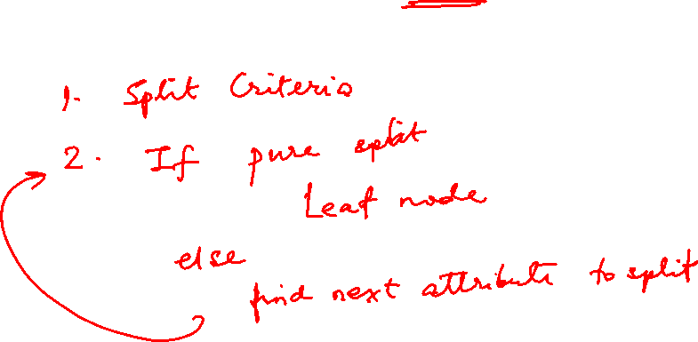
Decision Tree Construction: Hunts Algorithm
BITS Pilani, Deemed to be University under Section 3 of UGC Act, 1956

Slide 8
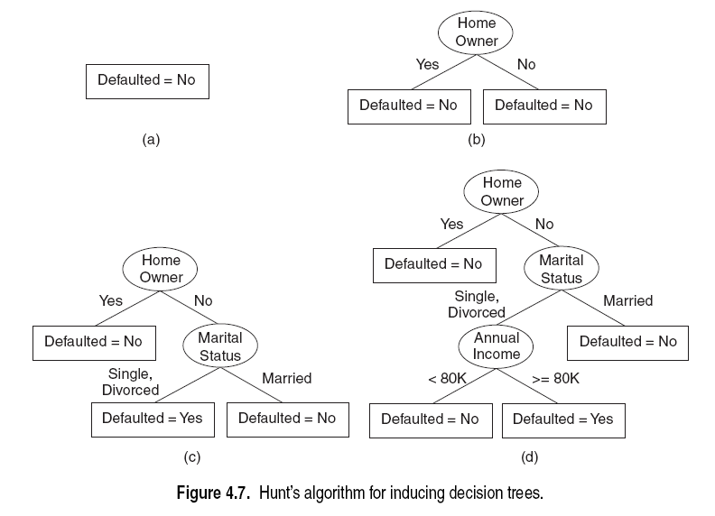
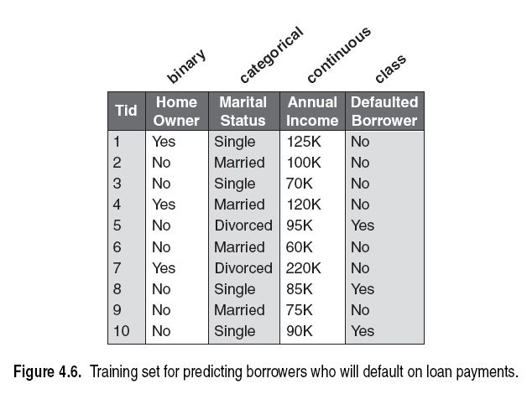
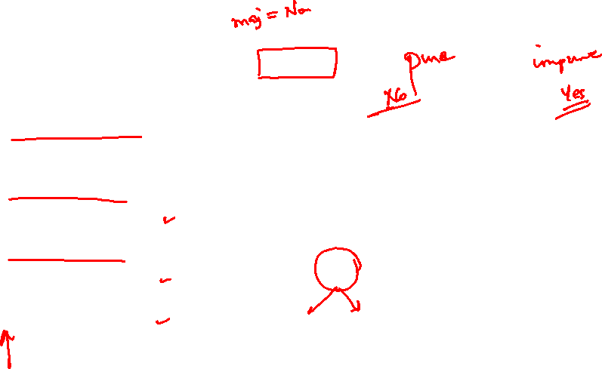
Decision Tree Construction: Example
BITS Pilani, Deemed to be University under Section 3 of UGC Act, 1956

Slide 9
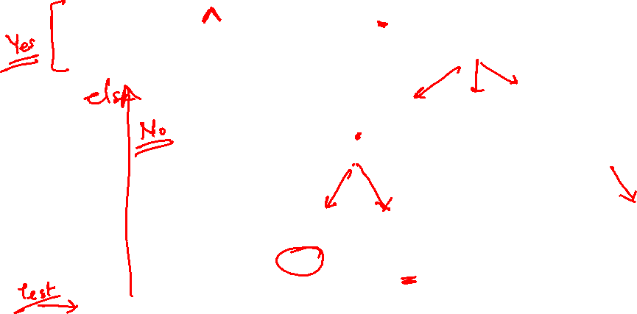
Decision Trees – Representation & Expressiveness
Decision trees represent a disjunction of conjunctions on constraints on the value of attributes:
  (Outlook = Sunny ∧ Humidity = Normal) ∨
  (Outlook = Overcast) ∨
  (Outlook = Rain ∧ Wind = Weak)
〈Outlook=Sunny, Temp=Hot, Humidity=High, Wind=Strong〉 No

Slide 10
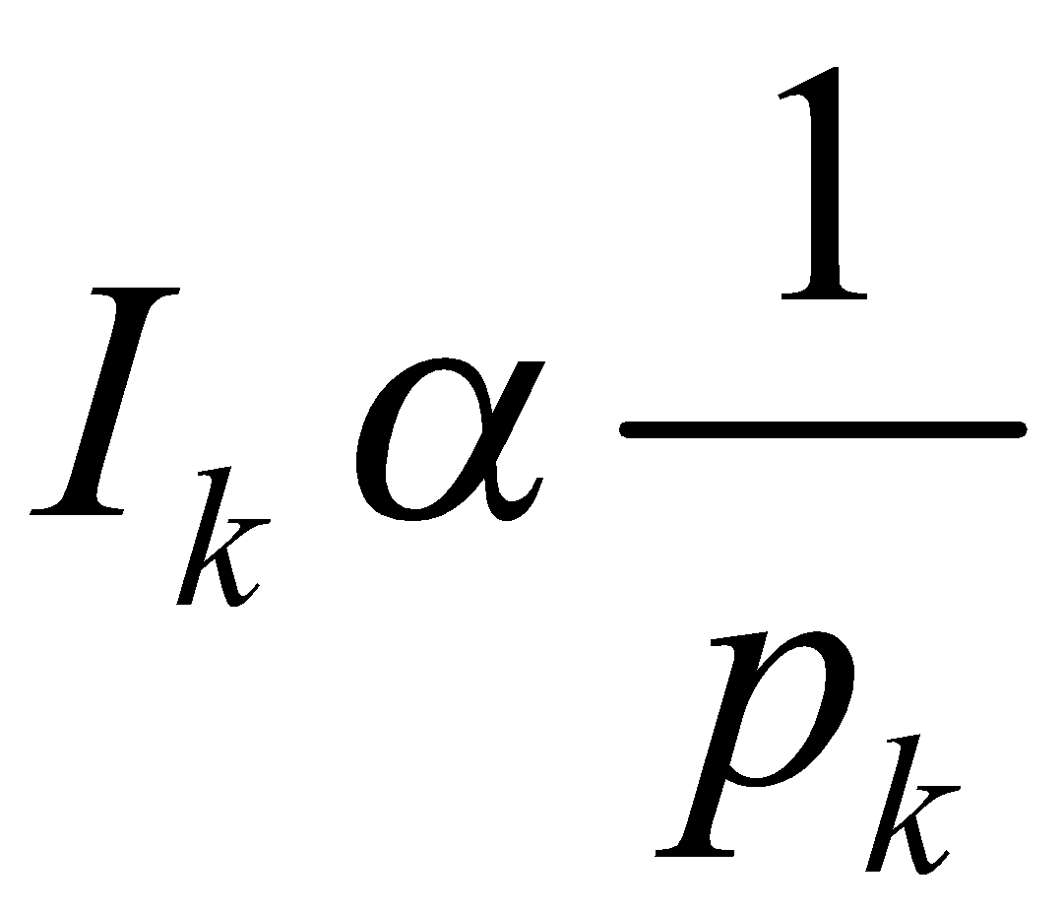
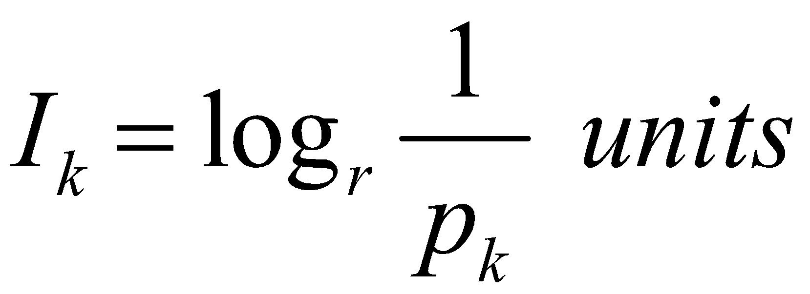
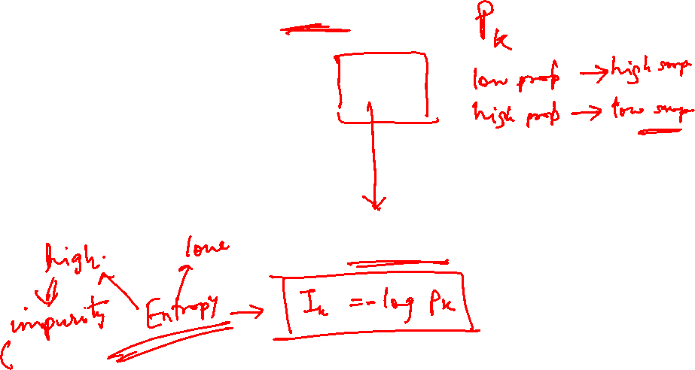
Measure of Information
The amount of information (surprise element) conveyed by a message is inversely proportional to its probability of occurrence. That is
The mathematical operator satisfies above properties is the logarithmic operator.

Slide 11

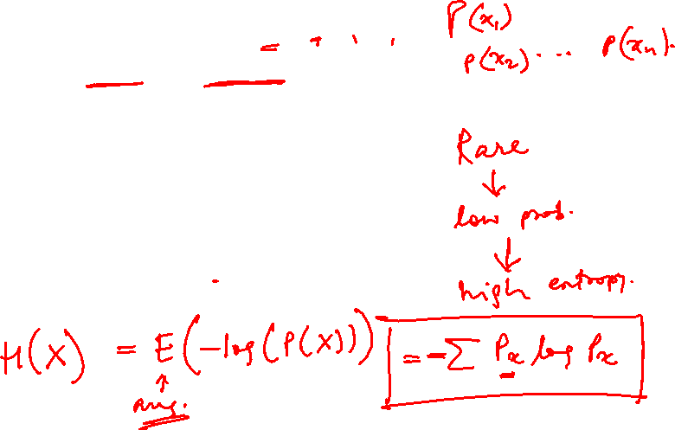
Entropy
Entropy of discrete random variable X={x₁, x₂…x_{n}}
since: log₂(1/P(event))= -log₂P(event)
As uncertainty increases, entropy increases
Entropy across all values

Slide 12
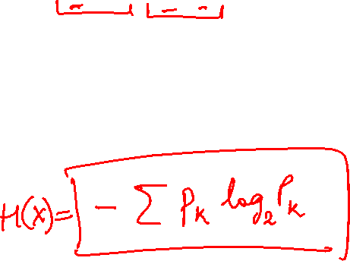
Entropy in general
Entropy measures the amount of information in a random variable
H(X) = – p₊ log₂ p₊ – p– log₂ p– X = {+, –}
for binary classification [two-valued random variable]
c c
H(X) = – Σ p_{i} log₂ p_{i} = Σ p_{i} log₂ 1/ p_{i} X = {i, …, c}
i=1 i=1
for classification in c classes

Slide 13
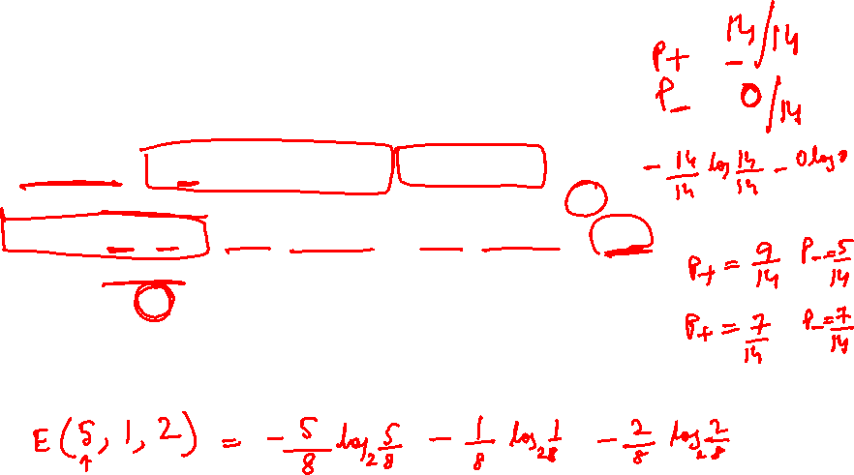
Entropy in binary Classification
Entropy measures the impurity of a collection of examples. It depends from the distribution of the random variable p.
  S is a collection of training examples
  p₊ the proportion of positive examples in S
  p– the proportion of negative examples in S
Entropy (S) ≡ – p₊ log₂ p₊ – p–log₂ p– [0 log₂0 = 0]
Entropy ([14+, 0–]) = – 14/14 log₂ (14/14) – 0 log₂ (0) = 0
Entropy ([9+, 5–]) = – 9/14 log₂ (9/14) – 5/14 log₂ (5/14) = 0.94
Entropy ([7+, 7– ]) = – 7/14 log₂ (7/14) – 7/14 log₂ (7/14) =
= 1/2 + 1/2 = 1 [log₂1/2 = – 1]
Note: the log of a number < 1 is negative, 0 ≤ p ≤ 1, 0 ≤ entropy ≤ 1
https://www.easycalculation.com/log-base2-calculator.php

Slide 14
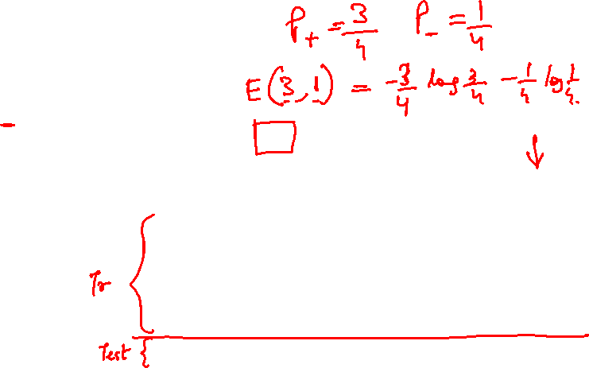
Decision Trees – Problem Type 1
Entropy of the Decision
Feature EnjoySport:
= Entropy _{DecisionClass}(S) = Ʃ-p(c) log₂ p(c)
= E(3,1) = – (3/4) log₂ (3/4) – (1/4) log₂ (1/4) = 0.4421+ 0.5 = 0.94
Sky | AirTemp | Humidity | Wind | Forecast | EnjoySport?
Sunny | Warm | Normal | Strong | Same | Yes
Sunny | Warm | High | Strong | Same | Yes
Rainy | Cold | High | Strong | Change | No
Sunny | Warm | High | Strong | Change | Yes
Rainy | Warm | Normal | Breeze | Same | Yes
Note:
Class balancing is recommended before building
Value = 0 to log base 2 k, where k is the number of classes you have.

Slide 15
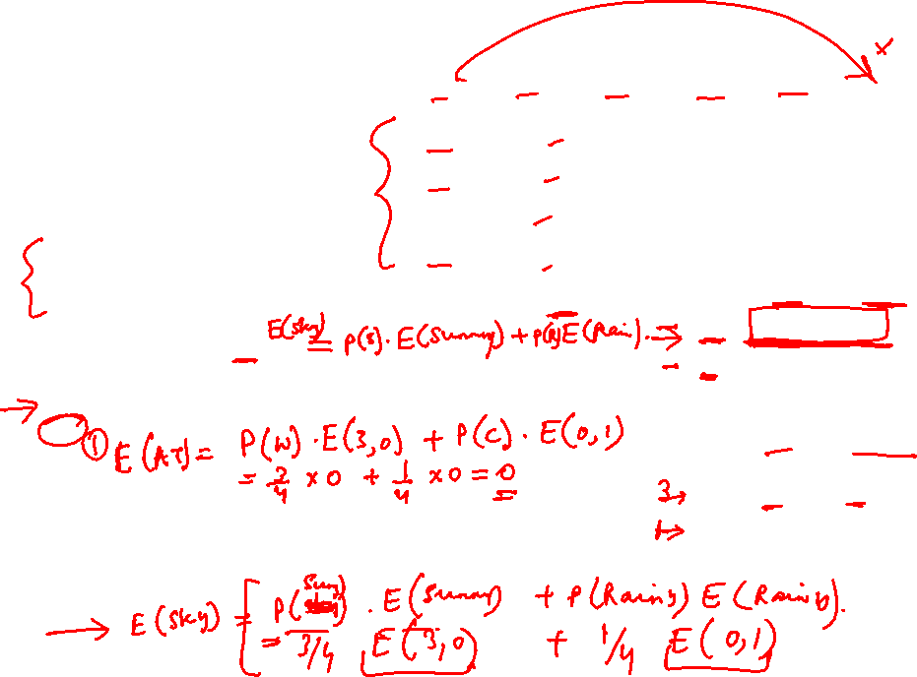
Decision Trees – Problem Type 1
Sky | AirTemp | Humidity | Wind | Forecast | EnjoySport?
Sunny | Warm | Normal | Strong | Same | Yes
Sunny | Warm | High | Strong | Same | Yes
Rainy | Cold | High | Strong | Change | No
Sunny | Warm | High | Strong | Change | Yes
Entropy of the Decision
Feature EnjoySport:
= Entropy _{DecisionClass}(S) = Ʃ-p(c) log₂ p(c)
= E(3,1) = – (3/4) log₂ (3/4) – (1/4) log₂ (1/4) = 0.4421+ 0.5 = 0.94
Entropy of the attribute Sky:
= p(Sunny) . E(3,0) + p( Rainy). E(0,1)
= (3/4) [– (3/3) log₂ (3/3) – (0/3) log₂ (0/3)] + (1/4) [– (0/1) log₂ (0/1) – (1/1) log₂ (1/1)]
= 0
Entropy of the attribute AirTemp:
= p(Warm) . E(3,0) + p( Cold). E(0,1)
= (3/4) [– (3/3) log₂ (3/3) – (0/3) log₂ (0/3)] + (1/4) [– (0/1) log₂ (0/1) – (1/1) log₂ (1/1)]
= 0
Sky | Enjoy | Not Enjoy
Sunny | 3 | 0
Rainy | 0 | 1
Air Temp | Enjoy | Not Enjoy
Warm | 3 | 0
Cold | 0 | 1

Slide 16

Decision Trees – Problem Type 1
Sky | AirTemp | Humidity | Wind | Forecast | EnjoySport?
Sunny | Warm | Normal | Strong | Same | Yes
Sunny | Warm | High | Strong | Same | Yes
Rainy | Cold | High | Strong | Change | No
Sunny | Warm | High | Strong | Change | Yes
Entropy of the Decision
Feature EnjoySport:
= Entropy _{DecisionClass}(S) = Ʃ-p(c) log₂ p(c)
= E(3,1) = – (3/4) log₂ (3/4) – (1/4) log₂ (1/4) = 0.94
Entropy of the attribute Humidity :
= p(Normal) . E(1,0) + p( High). E(2,1)
= (1/4) [– (1/1) log₂ (1/1) – (0/1) log₂ (0/1)] + (3/4) [– (2/3) log₂ (2/3) – (1/3) log₂ (1/3)]
= 0 + ¾ [0.39 + 0.52] = 0.68
Entropy of the attribute Wind :
= p(Strong) . E(3,1)
= (4/4) [– (3/4) log₂ (3/4) – (1/4) log₂ (1/4)]
= 1(0.94) = 0.94
Humidity | Enjoy | Not Enjoy
Normal | 1 | 0
High | 2 | 1
Wind | Enjoy | Not Enjoy
Strong | 3 | 1

Slide 17
Decision Trees – Problem Type 1
Sky | AirTemp | Humidity | Wind | Forecast | EnjoySport?
Sunny | Warm | Normal | Strong | Same | Yes
Sunny | Warm | High | Strong | Same | Yes
Rainy | Cold | High | Strong | Change | No
Sunny | Warm | High | Strong | Change | Yes
Entropy of the Decision
Feature EnjoySport:
= Entropy _{DecisionClass}(S) = Ʃ-p(c) log₂ p(c)
= E(3,1) = – (3/4) log₂ (3/4) – (1/4) log₂ (1/4) = 0.94
Entropy of the attribute Forecast :
= p(Same) . E(2,0) + p( Change). E(1,1)
= (2/4) [– (2/2) log₂ (2/2) – (0/2) log₂ (0/2)] + (2/4) [– (1/2) log₂ (1/2) – (1/2) log₂ (1/2)]
= 0 + 0.5 = 0.5
Forecast | Enjoy | Not Enjoy
Same | 2 | 0
Change | 1 | 1

Slide 18

Decision Trees – Problem Type 1
Entropy of the Decision Feature EnjoySport: 0.94
Entropy of the attribute Sky: 0
Entropy of the attribute AirTemp: 0
Entropy of the attribute Humidity: 0.68
Entropy of the attribute Wind: 0.94
Entropy of the attribute Forecast: 0.5
Attribute that generalizes the model faster = That which reduces the randomness if used to decide = That which have the highest info gain = SKY & AIRTEMP
Decision Tree constructed
(both are equally correct decision tree) :
Sky | AirTemp | Humidity | Wind | Forecast | EnjoySport?
Sunny | Warm | Normal | Strong | Same | Yes
Sunny | Warm | High | Strong | Same | Yes
Rainy | Cold | High | Strong | Change | No
Sunny | Warm | High | Strong | Change | Yes
AirTemp
Sky
Warm
Cold
Sunny
Rainy
YES
NO
YES
NO

Slide 19
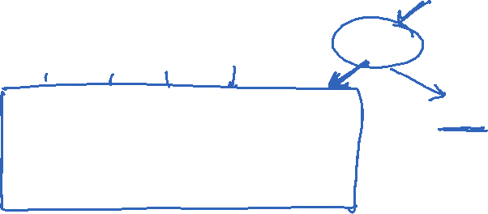
Decision Trees – Problem Type 2
(If there are heterogeneous nodes, continue the decision tree construction)
Sub Problem which has more scope to Model: None
Convergence Criteria :
Repeat the step again for the remaining features till:
All training data are learnt
No more learning is possible
Constraints posed by the hyperparameter satisfied (More on this will be discussed in the next session under handling overfitting)
Sky | AirTemp | Humidity | Wind | Forecast | EnjoySport?
Sunny | Warm | Normal | Strong | Same | Yes
Sunny | Warm | High | Strong | Same | Yes
Rainy | Cold | High | Strong | Change | No
Sunny | Warm | High | Strong | Change | Yes
Humidity
High
Normal
Sky | AirTemp | Wind | Forecast | EnjoySport?
Sunny | Warm | Strong | Same | Yes
Rainy | Cold | Strong | Change | No
Sunny | Warm | Strong | Change | Yes
YES
Assumed sample data in the node

Slide 20

Information gain as entropy reduction
Information gain is the expected reduction in entropy caused by partitioning the examples on an attribute.
The higher the information gain the more effective the attribute in classifying training data.
Expected reduction in entropy knowing A
Gain(S, A) = Entropy(S) − Σ Entropy(S_{v})
v ∈ Values(A)
Values(A) possible values for A
S_{v} subset of S for which A has value v
|Sv|
|S|
Maximizing the gain = minimizing the weighted average impurity measure of children nodes

Slide 21
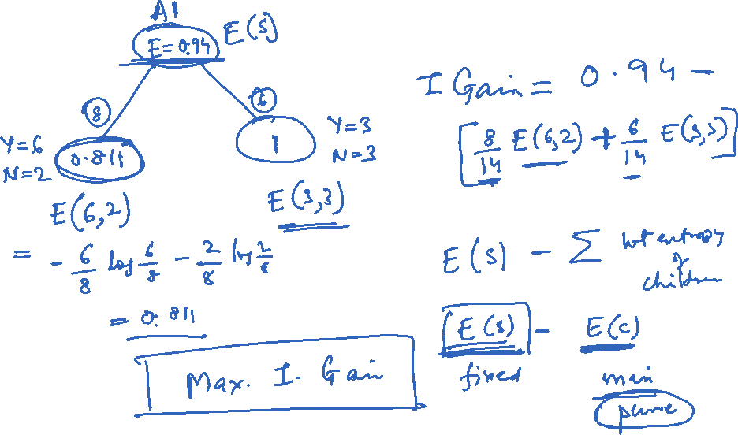

Slide 22
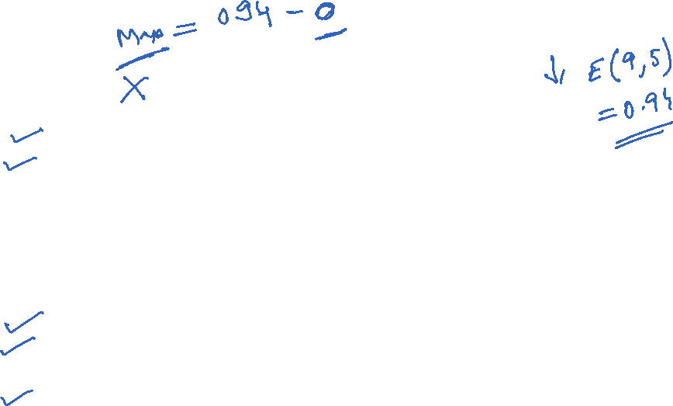
Example
Notes:
Target attrbute = playtennis

Slide 23
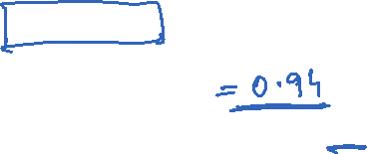
Example: Information gain
Let
  Values(Wind) = {Weak, Strong}
  S = [9+, 5−]
  S_{Weak} = [6+, 2−]
  S_{Strong} = [3+, 3−]
Information gain due to knowing Wind:
Gain(S, Wind) = Entropy(S) − 8/14 Entropy(S_{Weak}) − 6/14 Entropy(S_{Strong})
  = 0.94 − 8/14 × 0.811 − 6/14 × 1.00
  = 0.048

Slide 24
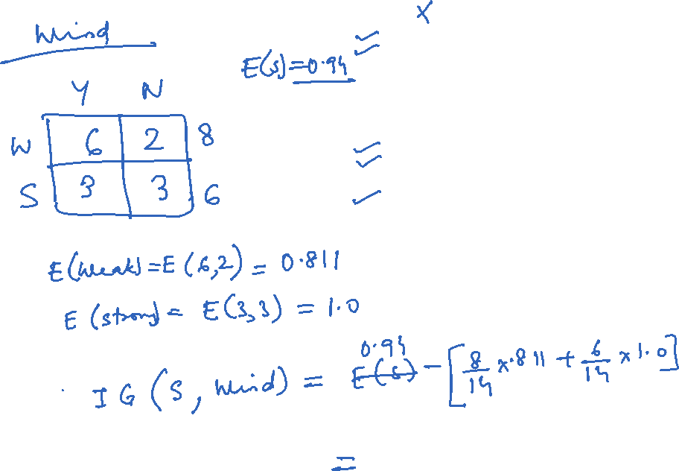

Slide 25
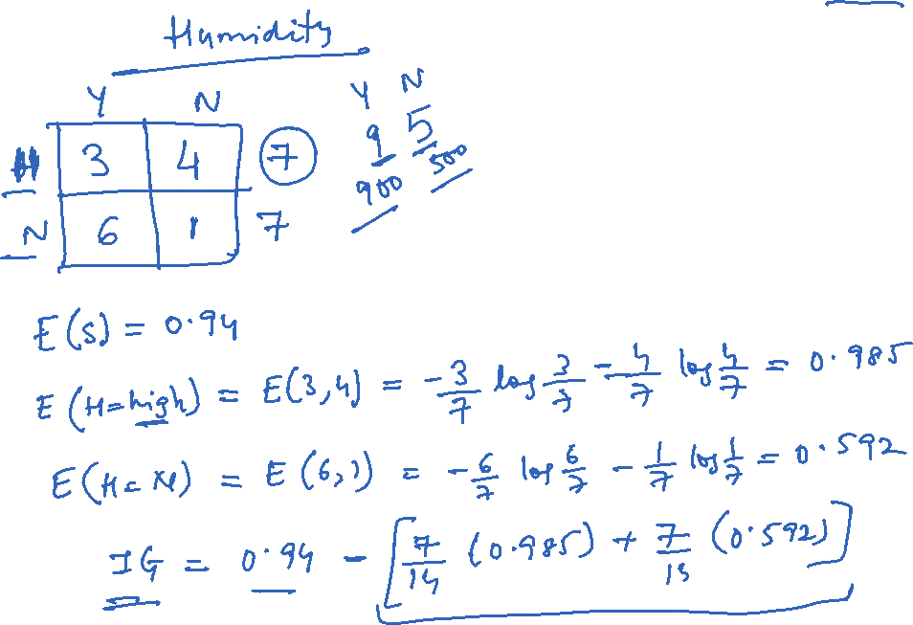

Slide 26
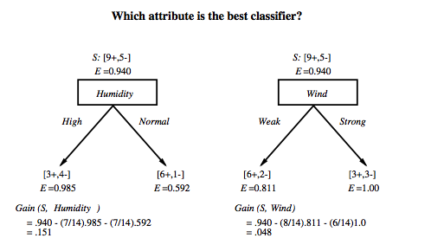
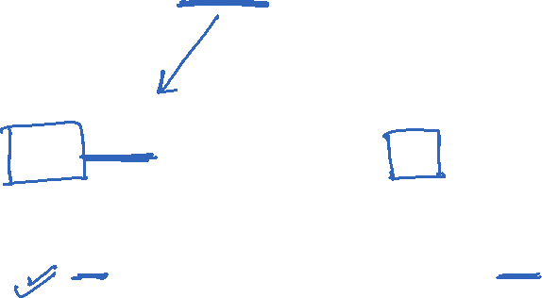
Which attribute is the best classifier?

Slide 27

First step: which attribute to test at the root?
Which attribute should be tested at the root?
  Gain(S, Outlook) = 0.246
  Gain(S, Humidity) = 0.151
  Gain(S, Wind) = 0.084
  Gain(S, Temperature) = 0.029
Outlook provides the best prediction for the target
Lets grow the tree:
  add to the tree a successor for each possible value of Outlook
  partition the training samples according to the value of Outlook

Slide 28
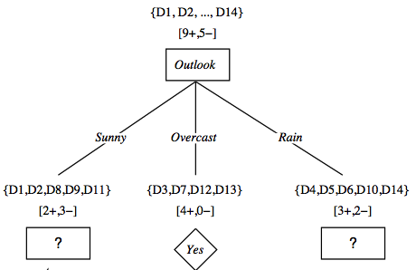
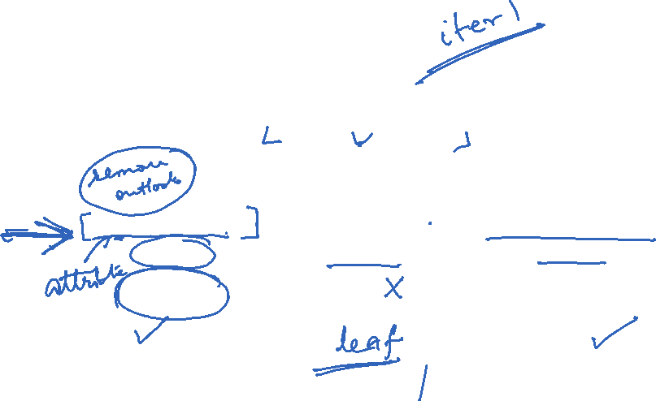
After first step

Slide 29

Second step
Working on Outlook=Sunny node:
  Gain(S_{Sunny}, Humidity) = 0.970 − 3/5 × 0.0 − 2/5 × 0.0 = 0.970
  Gain(S_{Sunny}, Wind) = 0.970 − 2/5 × 1.0 − 3.5 × 0.918 = 0 .019
  Gain(S_{Sunny}, Temp.) = 0.970 − 2/5 × 0.0 − 2/5 × 1.0 − 1/5 × 0.0 = 0.570
Humidity provides the best prediction for the target
Lets grow the tree:
  add to the tree a successor for each possible value of Humidity
  partition the training samples according to the value of Humidity

Slide 30
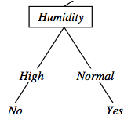
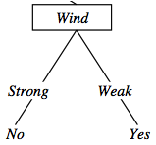
Second and third steps
{D1, D2, D8}
No
{D9, D11}
Yes
{D4, D5, D10}
Yes
{D6, D14}
No

Slide 31
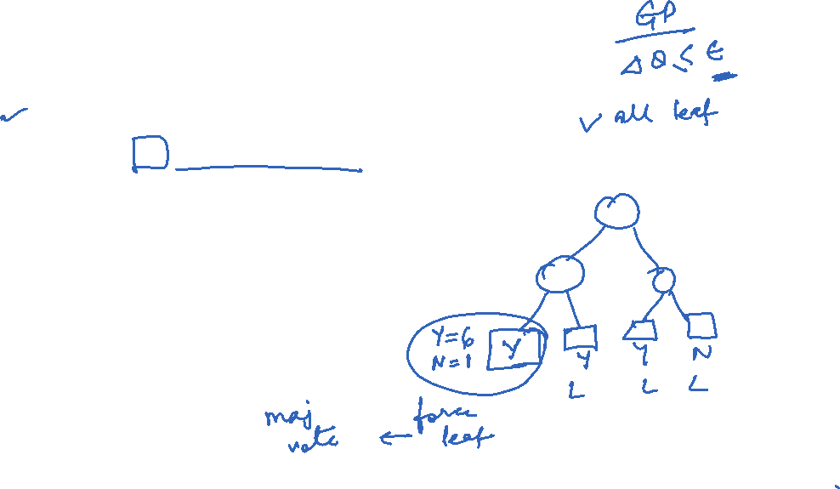
Convergence of Algorithm
•Conditions for stopping partitioning
  • All samples for a given node belong to the same class
  • There are no remaining attributes for further partitioning – majority voting is employed for classifying the leaf
  • There are no samples left

Slide 32
ID3: algorithm -Summary
ID3(X, T, Attrs) X: training examples:
T: target attribute (e.g. PlayTennis),
Attrs: other attributes, initially all attributes
Create Root node
If all X's are +, return Root with class +
If all X's are –, return Root with class –
If Attrs is empty return Root with class most common value of T in X
else
A ← best attribute; decision attribute for Root ← A
For each possible value v_{i} of A:
- add a new branch below Root, for test A = v_{i}
- X_{i} ← subset of X with A = v_{i}
- If X_{i} is empty then add a new leaf with class the most common value of T in X
else add the subtree generated by ID3(X_{i}, T, Attrs − {A})
return Root

Slide 33

Decision Trees – Problem Type 3
Sky | AirTemp | Humidity | Wind | Forecast | EnjoySport?
Sunny | Warm | Normal | Strong | Same | Yes
Sunny | Warm | High | Strong | Same | Yes
Rainy | Cold | High | Strong | Change | No
Sunny | Warm | High | Strong | Change | Yes
Rainy | Warm | Normal | Breeze | Same | ????
Predict the class for new input instance 🡪
Sky
Sunny
Rainy
YES
NO

Slide 34

Decision Trees – Problem Type 3
Predict the output for this data sample
{D1, D2, D8}
No
{D9, D11}
Yes
{D4, D5, D10}
Yes
{D6, D14}
No

Slide 35

Problem Type 4 – Evaluate the model
Confusion Matrix
Actual class\Predicted class | C₁ | ¬ C₁
C₁ | True Positives (TP) | False Negatives (FN)
¬ C₁ | False Positives (FP) | True Negatives (TN)
The evaluation discussed under module 4 is applicable here
By default , model’s predictive quality is evaluated only by the unseen validation/test instances.
When training performance (eg., accuracy) is required for comparison, the training instances are used for assessment
CM_{i,j} indicates the number of tuples of class i that were labelled by the classifier as class j.
Sky | AirTemp | Humidity | Wind | Forecast | EnjoySport?
Sunny | Warm | Normal | Strong | Same | Yes
Sunny | Warm | High | Strong | Same | Yes
Rainy | Cold | High | Strong | Change | No
Sunny | Warm | High | Strong | Change | Yes
Rainy | Warm | Normal | Breeze | Same | Yes
Sky
Sunny
Rainy
YES
NO

Slide 36

Decision trees
Advantages:
    – Inexpensive to construct
    – Extremely fast at classifying unknown records
    – Easy to interpret for small-sized trees
    – Can easily handle redundant or irrelevant attributes (unless the attributes are interacting)
Disadvantages:
    – Space of possible decision trees is exponentially large.
    -- Greedy approaches are often unable to find the best tree.
    – Does not take into account interactions between attributes
    – Each decision boundary involves only a single attribute

Slide 37
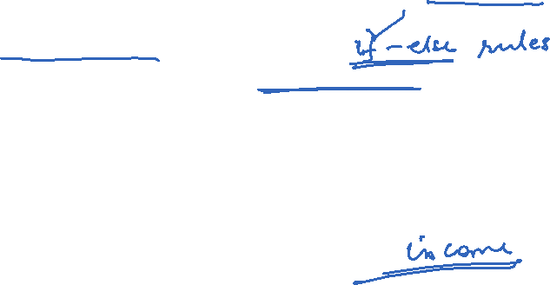
Applications
Suited for following classification problems:
Applications whose Instances are represented by attribute-value pairs.
The target function has discrete output values
Disjunctive descriptions may be required
The training data may contain missing attribute values
Real world applications
Biomedical applications
Manufacturing
Banking sector
Make-Buy decisions

Slide 38
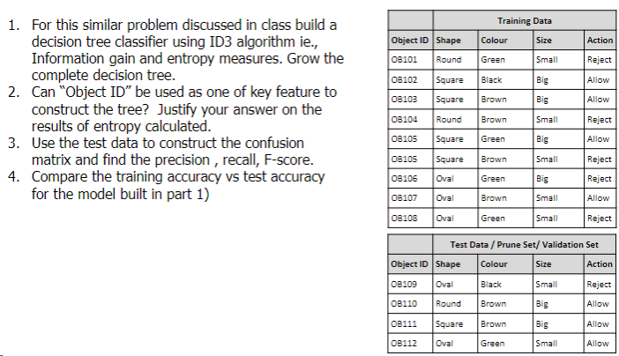
Practice Exercises (for Students)

Slide 39
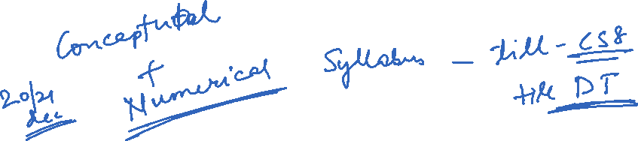
Mid Term Examination
Important Note to students:
Handout mapped prescribed book sections, class discussions , practice exercises shared in all the slides must be revised for the exam preparation
Since the mid term exam is CLOSED BOOK mode, no reference material is allowed and hence formula needs to be learnt by the students
Queries may not be answered once the exam starts.
Kindly Plan ahead to get your preparation queries resolved before the EXAM START DATE of your batch.

Slide 40
Additional References
Decision Tree
https://www.youtube.com/watch?v=eKD5gxPPeY0&list=PLBv09BD7ez_4temBw7vLA19p3tdQH6FYO&index=1

Slide 41
Thank you !

